Slide 1
October 12, 2017
Jesse A. Elam

Slide 2
Project purpose and overview: Why CMAP is developing the Vision

Slide 3
Project purpose and overview
Purpose: Create a bold, multimodal, multijurisdictional vision for the northeastern Illinois expressway system
Objectives:
Chart a course for the system to guide future IDOT and Tollway capital programs and operating policies, to address the most intractable congestion, and to provide game-changing mass transit options.
Inform ON TO 2050, the region’s long-term comprehensive plan development process.

Slide 4
Project Schedule
Time | Activities
Spring, 2017 | Project goals, committee engagement
Summer, 2017 | Consultant start, trends/strategies
Fall, 2017 | Corridor recommendations, committee and stakeholder engagement
Winter, 2018 | Stakeholder engagement, ON TO 2050 coordination
April, 2018 | Draft Vision, committee and public engagement
May, 2018 | Final deliverables due

Slide 5
Project goals: What the Vision will accomplish

Slide 6
Support the region’s economy
Promote long-term regional economic growth
Improve truck freight movement
Make the expressway system financially sustainable

Slide 7
Enhance operations
Provide game-changing mass transit improvements
Prepare for vehicle automation and leverage communications technologies
Achieve a state of good repair
Improve safety
Address the most intractable congestion issues

Slide 8
Manage environmental impacts
Improve roadway environmental performance
Reduce negative impacts on neighborhoods
Adapt to a changing climate
Leverage expressway right-of-way for broader needs (such as stormwater management, communications, utilities, and energy production)

Slide 9
Corridor improvements

Slide 10
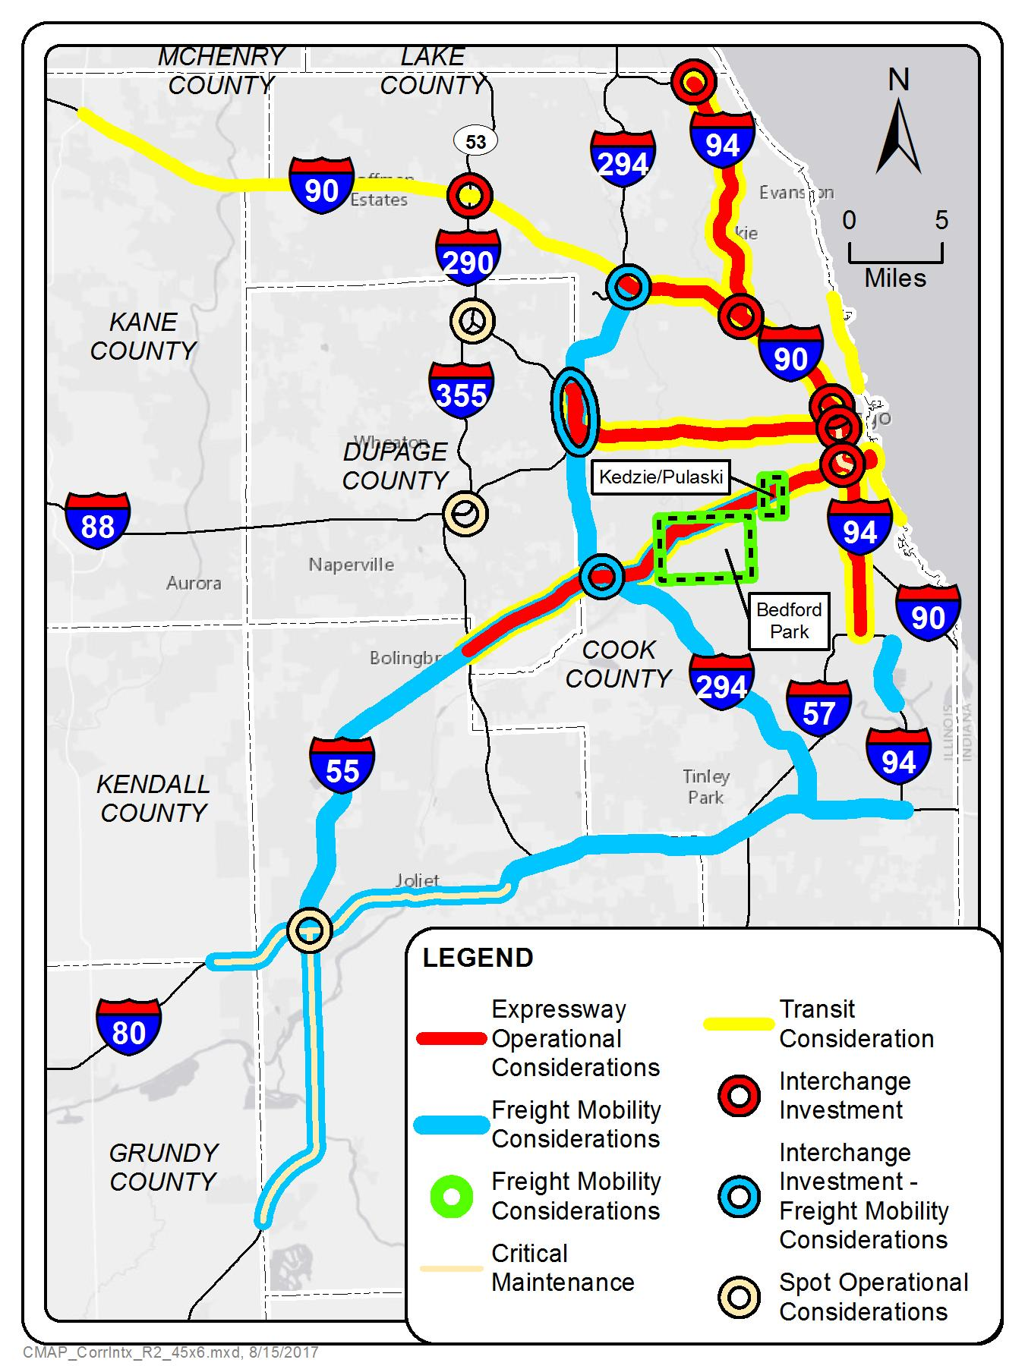
Corridor identification
The first big lesson we’ve learned is that decades of insufficient funding have left the IDOT expressway system in need of improvements.
Nearly everywhere.
Now.

Slide 11
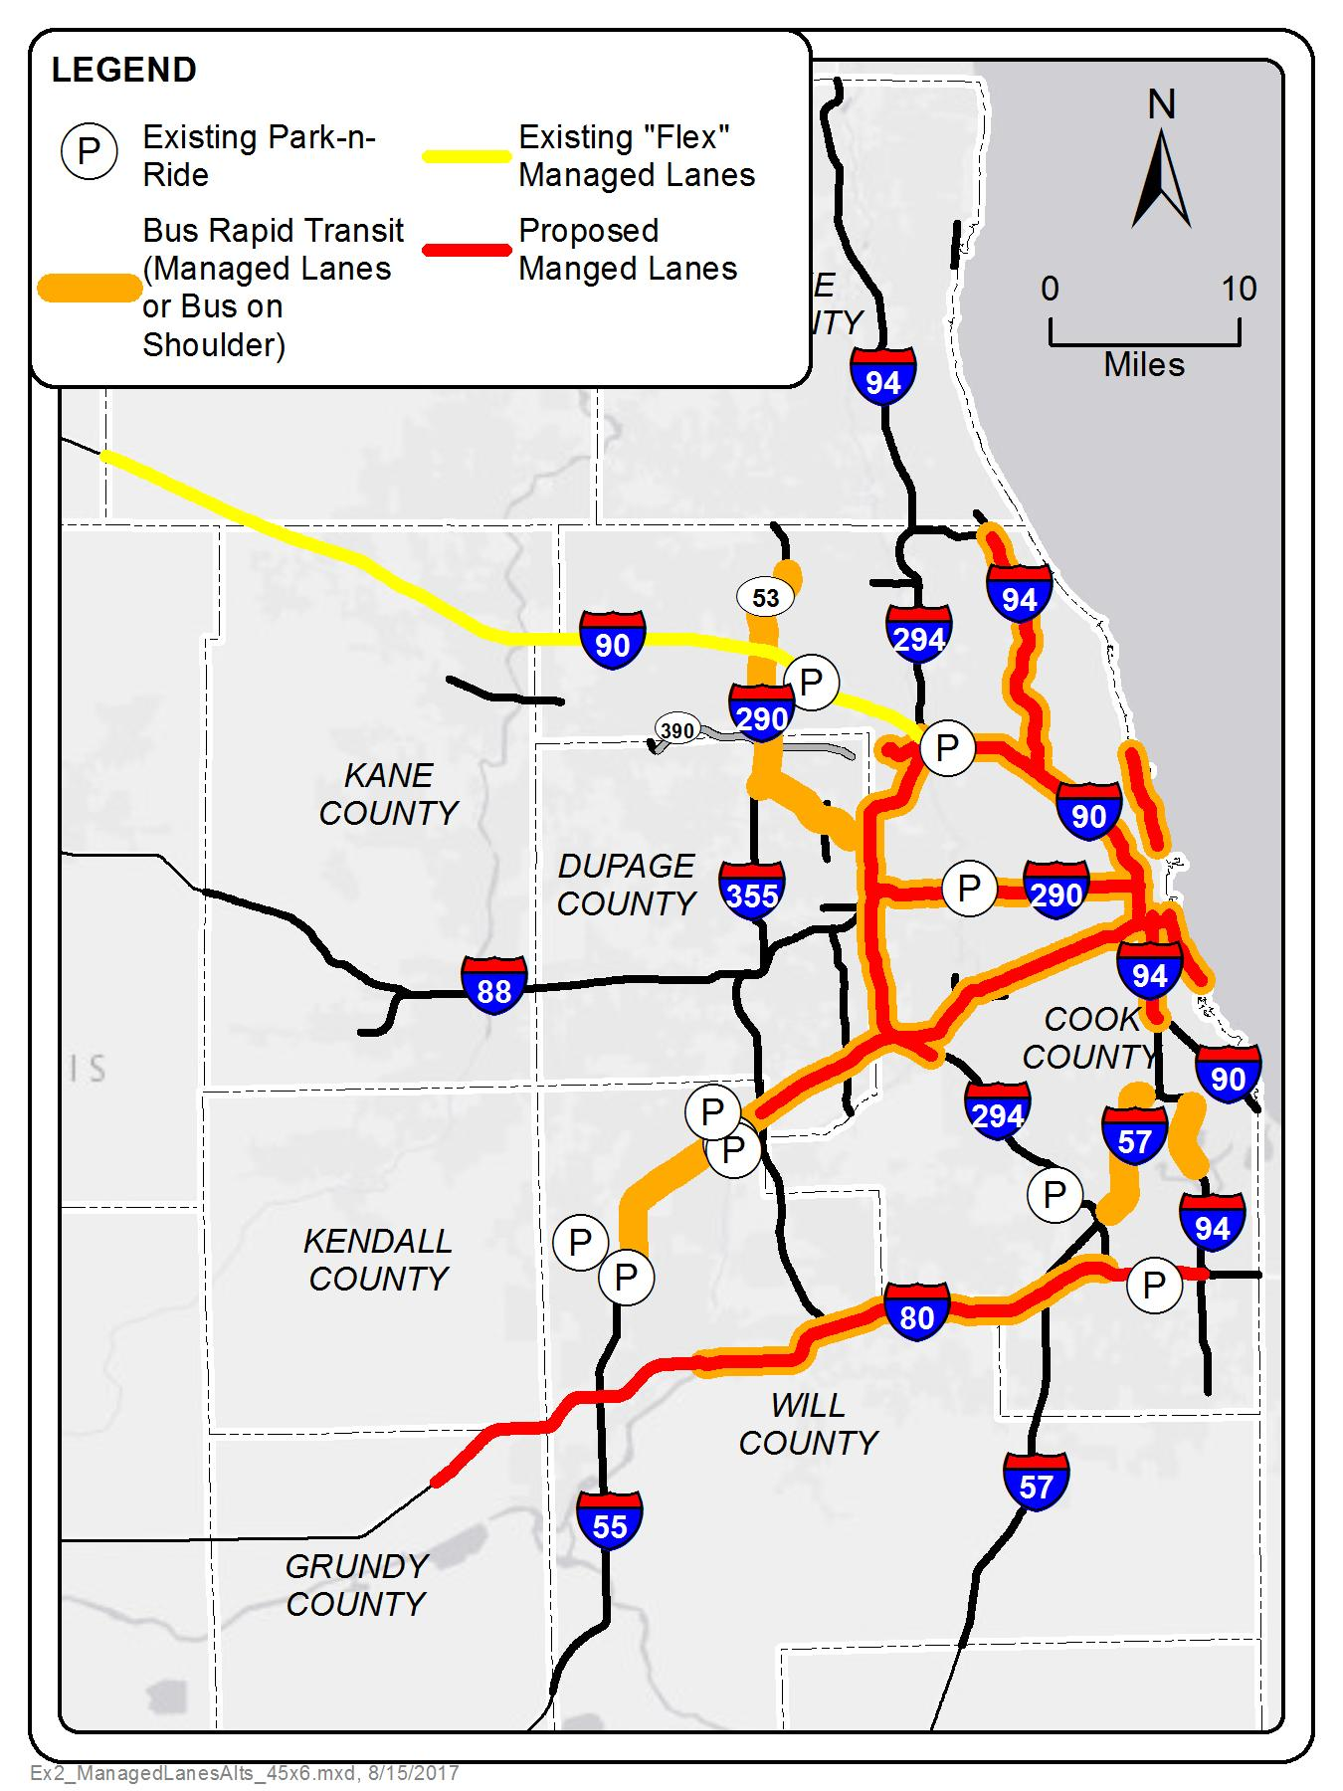
Managed lane network
Edens, Kennedy, Eisenhower, Stevenson, North Lake Shore Dr, South Lake Shore Dr
2-3 ML + 2 or more GPL
Painted buffer
Includes transit
Dan Ryan
Conversion of express lanes to managed lanes
I-80
1 truck lane & 1 flex lane + 2 GPL
Includes transit
I-294 Tri-state
1 flex lane + 4 GPL
Includes transit
I-190
Shoulder riding
Additional bus on shoulder accommodations, including I-290, I-55 west of I-355, I-57, I-94
Notes:
C

Slide 12
Typical cross section for managed lanes
Toll lane dynamically priced to improve corridor mobility
General design
Two managed lanes in each direction
Separated from general purpose lanes by 4’ painted buffer
Continuous access
Actual lane configurations and dimensions to be determined by corridor; based on capacity needs, geometric constraints
Marie

Slide 13
Transit improvements (introduction)
Express bus, bus rapid transit, and bus-on-shoulder services on expressways
Enhanced infrastructure and service on existing rail lines
Transit infrastructure and transit service funding from expressway toll and managed lane revenues
Notes:
Pace's I-90 Market Expansion Program aims to improve transit service and supportive infrastructure along the corridor between Randall Road and Rosemont. In December 2016, Pace launched its largest ever service expansion with the addition of six new routes, enhanced service on five routes, and the opening of the I-90/Randall Road Park-n-Ride Station. That was just the beginning. This summer Pace buses will be able to travel in the new transit-only Flex Lanes when congestion is present.

Slide 14
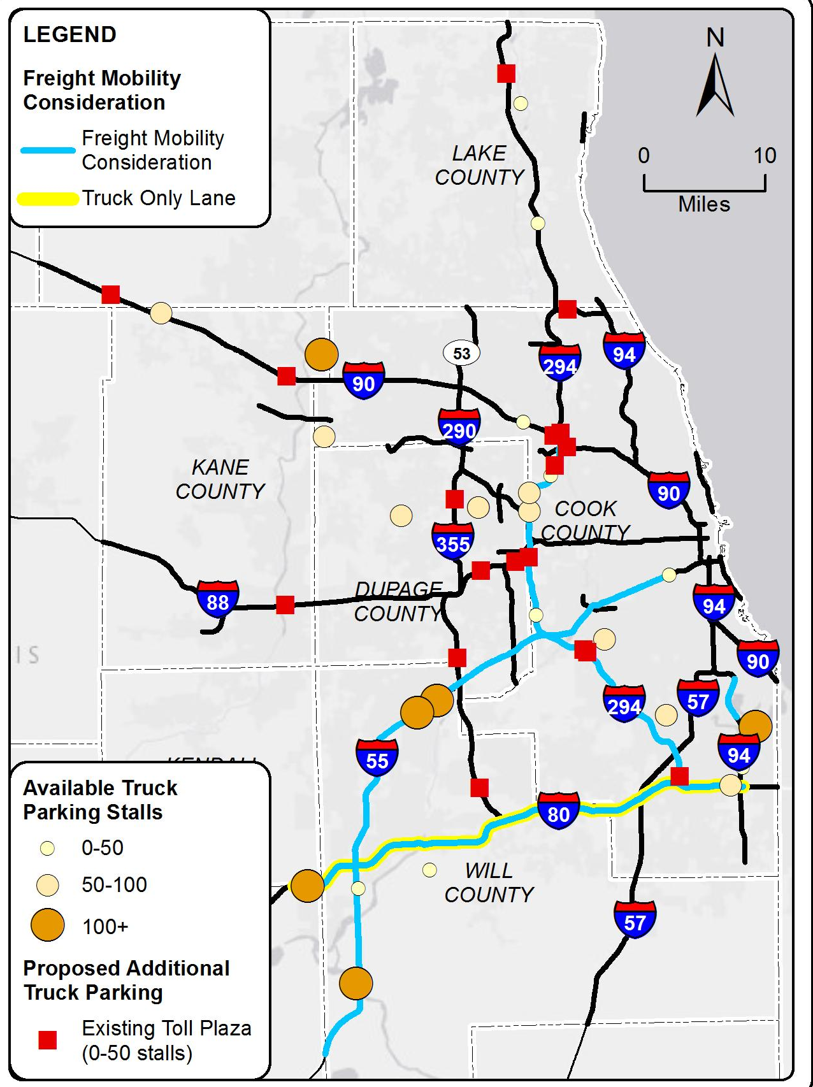
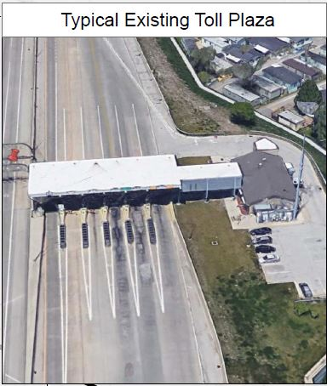
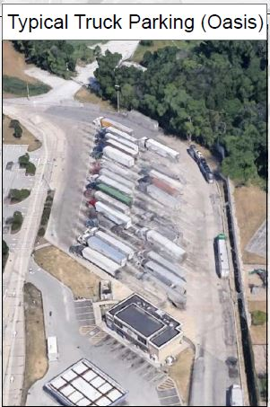
Freight mobility
Provide sustainable regional truck parking
Improve access to intermodal facilities
I-55 (Bedford Park, Kedzie/Pulaski)
I-294
Truck platooning and truck lanes on the I-80 corridor

Slide 15
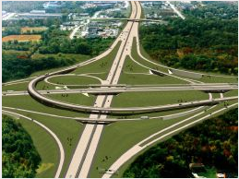
System interchange operations at major existing junctions
Existing
I-88/I-355
I-190/I-294/I-90/US 45 (near O’Hare)
Phase I/Master Plan
I-290/I-294/I-88
I-55/I-294
I-55/I-80
Phase II/III
I-90/I-94/I-290 (Jane Byrne Interchange)

Slide 16
Policy framework

Slide 17
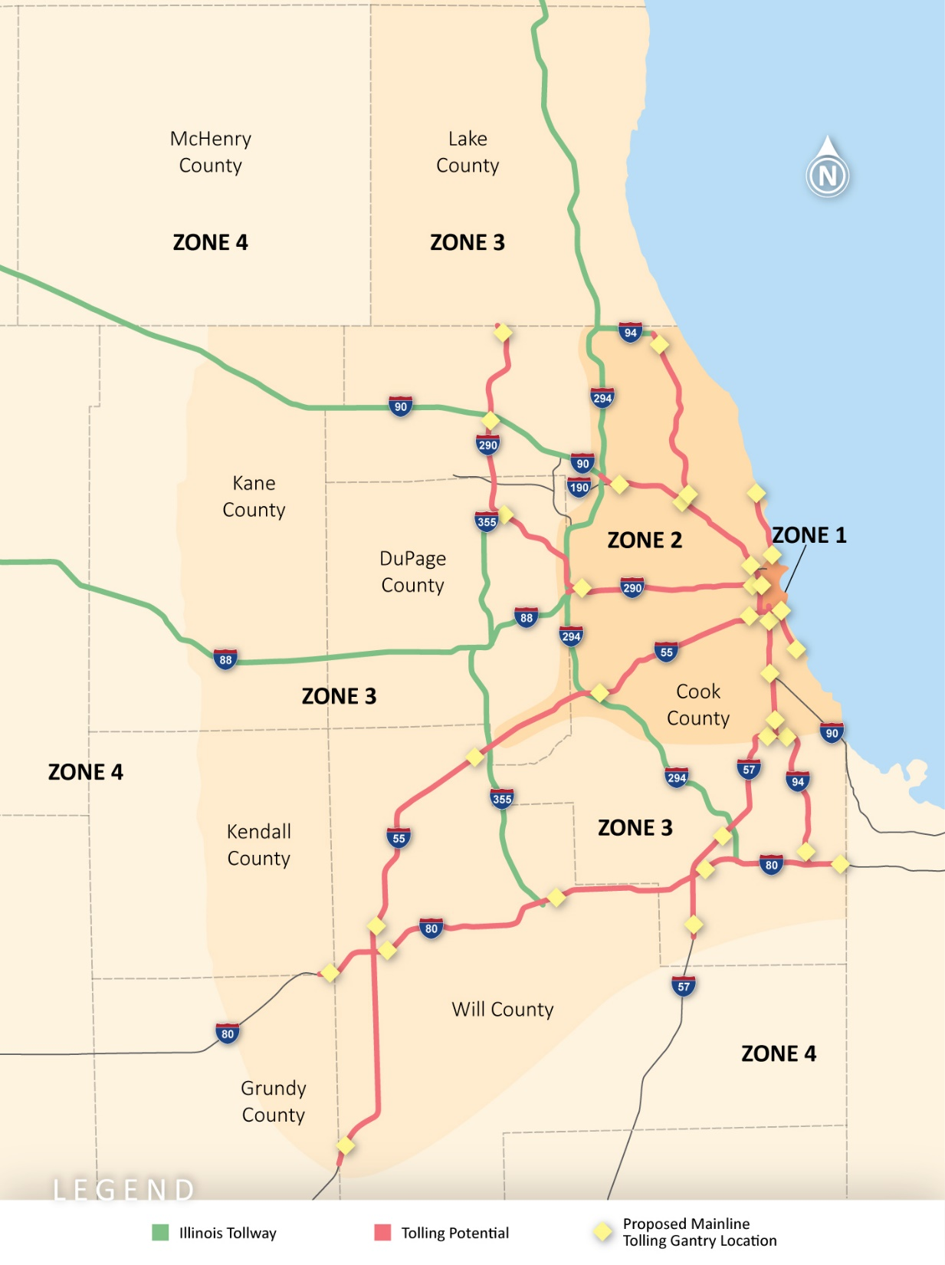
Full-scale tolling
Generate new revenues systemwide
Variable pricing
Toll gantries along mainline and on ramps
All-electronic tolling
Identify lanes within corridors for automated/connected vehicles

Slide 18
Policy framework
Coordinated operations – e.g., tolling/pricing, transportation management centers, incident management, emergency services
Shared revenue – use of revenues to support roads, transit capital, and transit operations
Exploring a sliding-scale toll discount program for individuals based on need
Notes:
How should revenue be allocated?
CH2M team will investigate likely impacts on low-income communities from pricing strategies, especially if the
recommendations include pricing existing roadway capacity. The team will identify geographic zones
and impact areas based on income thresholds using socio-economic data available from CMAP along with
origin-destination patterns using the travel demand model. The team will use experiences from similar
studies such as the I-15 corridor study for Nevada DOT to investigate viability of discount programs for using
priced lanes based on vehicle registration and zip-codes for low-income communities. In addition, the team
will investigate incorporating enhanced transit service to include express bus service within the priced lane
or express light-rail service as a desirable and reliable transportation option.

Slide 19
ON TO 2050 coordination
The ON TO 2050 comprehensive regional plan must meet federal standards of “fiscal constraint.”
Similarly constraining the Expressway Vision would defeat the purpose -- it must be expansive.
CMAP's process to develop the Expressway Vision is distinct from but complements the agency's concurrent development of ON TO 2050.
The draft Expressway Vision will be available for stakeholder and public engagement in April 2018.
The draft ON TO 2050 plan will be issued for public comment in June 2018, followed by adoption in October.

Slide 20
October 12, 2017

